Slide 1

Sequence to sequence models
Attention model
deeplearning.ai

Slide 2


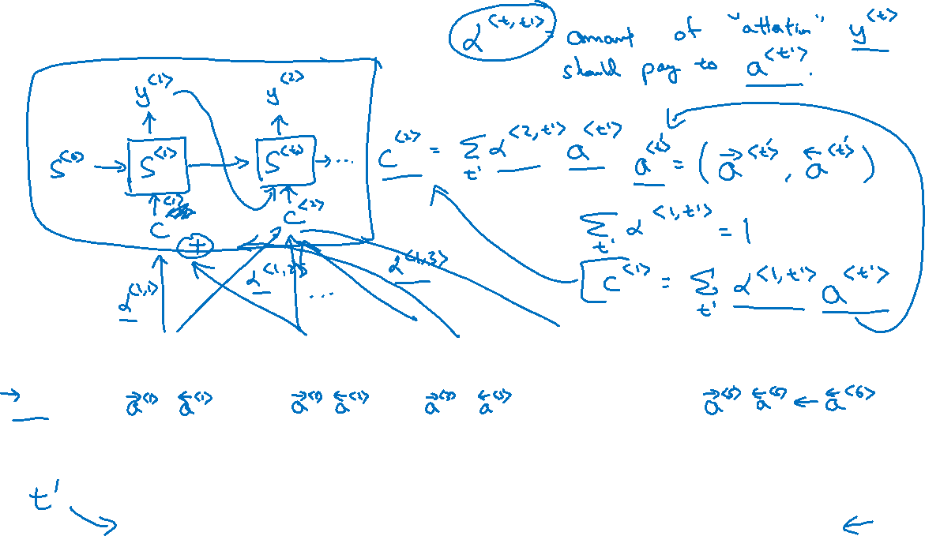




Attention model
$$a^{<0>}$$
$$x^{<1>}$$
$$x^{<2>}$$
$$x^{<3>}$$
$$x^{<4>}$$
$$x^{<5>}$$
jane
visite
l’Afrique
en
septembre
[Bahdanau et. al., 2014. Neural machine translation by jointly learning to align and translate]

Slide 3
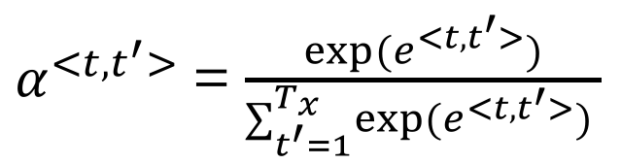
















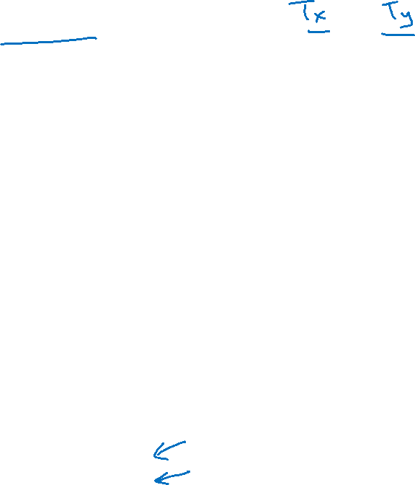
Computing attention $α^{<t,t^{′}>}$
$α^{<t,t^{′}>}$ = amount of attention $y^{<t >}$ should pay to $a^{<t^{′}>}$
$${\hat{y}}^{<t−1>}$$
$${\hat{y}}^{<t>}$$
$α^{<t,t^{′}>}$ = $\frac{exp⁡(e^{<t,t^{′}>})}{∑_{t^{′}=1}^{T_{x}}exp⁡(e^{<t,t^{′}>}) }$
$$s^{<t−1>}$$
$$s^{<t>}$$
$$+$$
$$s^{<t−1>}$$
$$e^{<t,t^{′}>}$$
$$a^{<t^{′}>}$$
$$a^{<0>}$$
$$⋯$$
$$x^{<1>}$$
$$x^{<2>}$$
$$x^{<T_{x}−1>}$$
$$x^{<T_{x}>}$$
[Bahdanau et. al., 2014. Neural machine translation by jointly learning to align and translate]
[Xu et. al., 2015. Show, attend and tell: Neural image caption generation with visual attention]

Slide 4
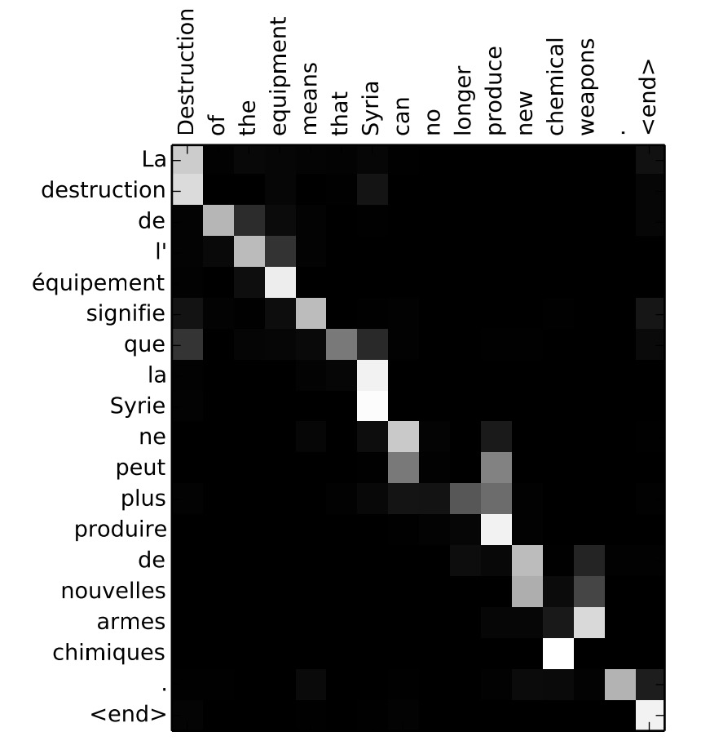

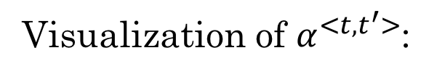

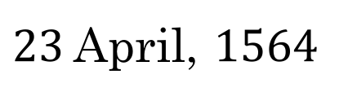
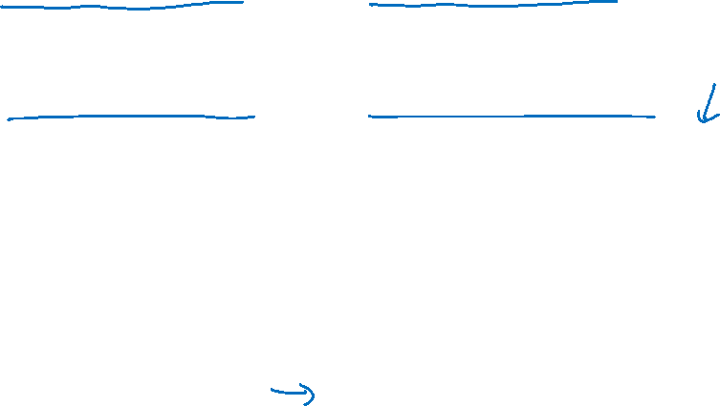
Attention examples
July 20th 1969
$1969−07−20$
${23}^{ }$April, $1564$
$1564−04−23$
Visualization of $α^{<t,t^{′}>}$:

